Slide 1

Build a small chat service and deploy it on Amazon ec2 using AWS
Tam Ly (On behalf of Ohhi.vn team )

Slide 2
Agenda
Introduction.
Architecture.
Use cases.
Demo (Locally).
EC2 Amazon AWS?.
Demo ( EC2 instance).
Q & A.

Slide 3
Ohhi team (https://ohhi.vn)
Started from January 2023.
Came from Erlang’s world.
Focus to Elixir ecosystem.
Have some open source projects (https://github.com/ohhi-vn).
Try to make new funny thing for people.
Contact: info@ohhi.vn

Slide 4
About me
Software Engineer with 5+ years experience working with Erlang ecosystem.
1+ year with Elixir.
Current company and position: Cisco Consultant at Adabeat company.
My linkedIn: Tam Nhat Ly (http://linkedin.com/in/tam-nhat-ly)

Slide 5

Architecture

Slide 6
Technique
Tools
LiveView
Live Component
Java Scripts
Channels
PubSub
Ecto
Sqlite3
Docker
EC2 AWS

Slide 7
Model
Store at lib/chat_service/room/
Migrations are used to modify database schema over time: priv/repo/migrations/*_create_room_table.exs

Slide 8
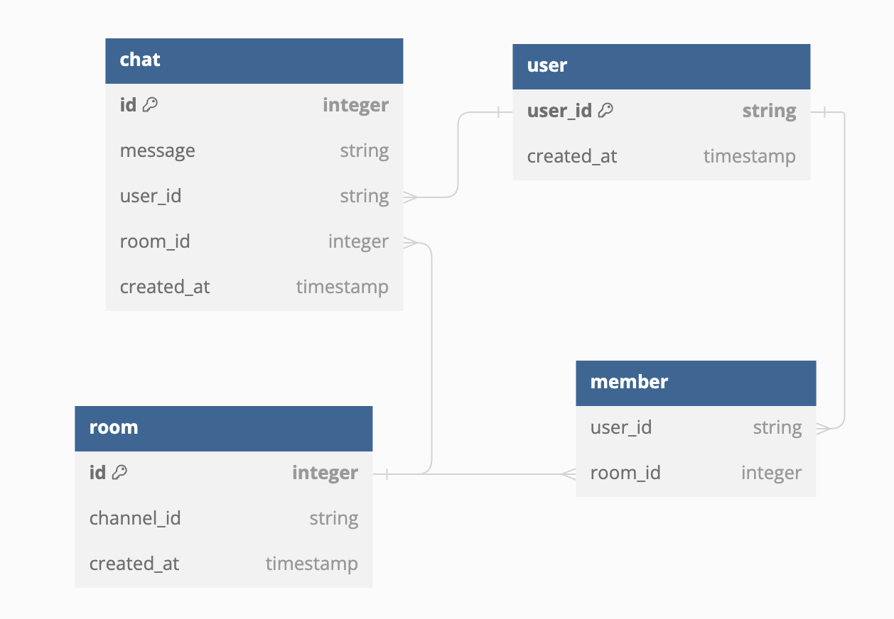
Database

Slide 9
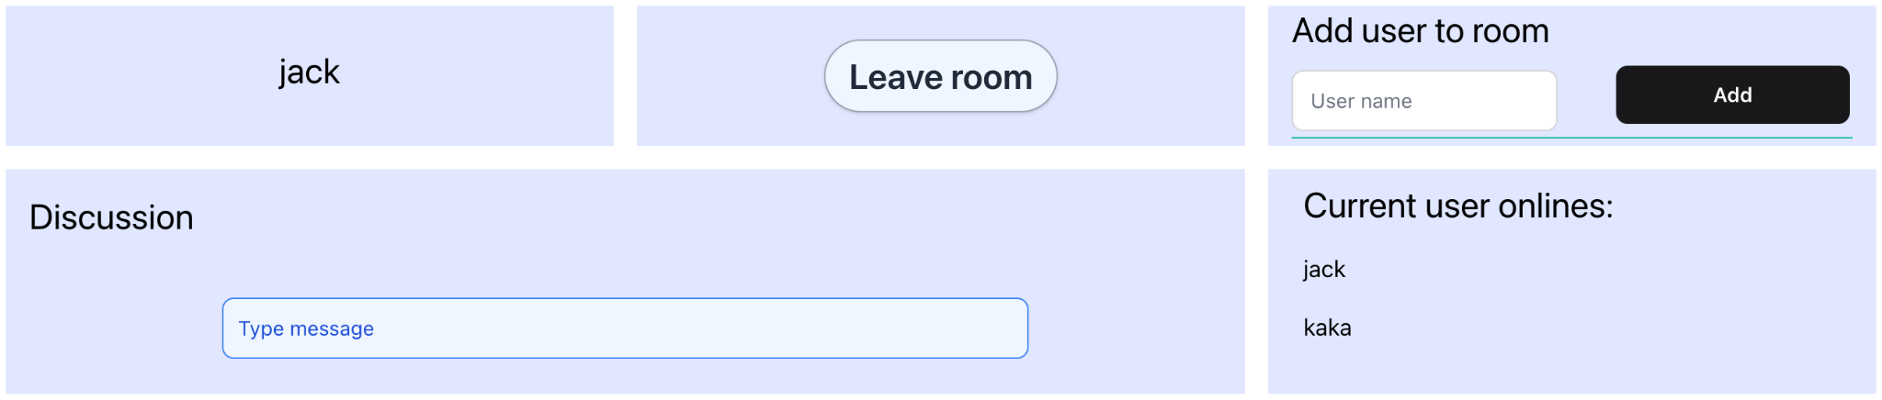
Chat room page

Slide 10
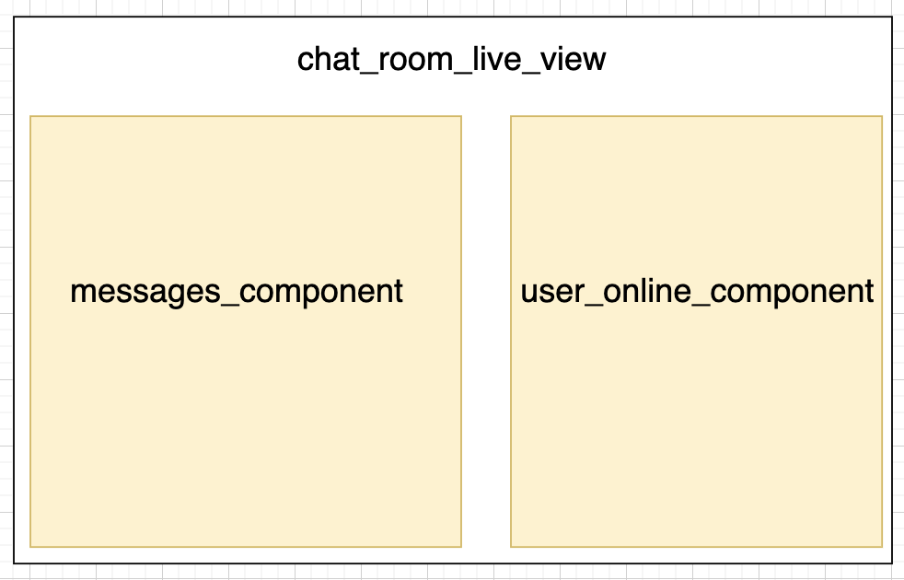
LiveView/Live Componnent

Slide 11
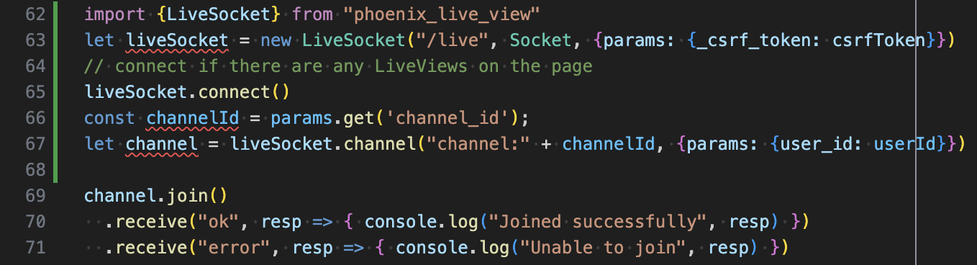
Channels
Client side: app.js

Slide 12
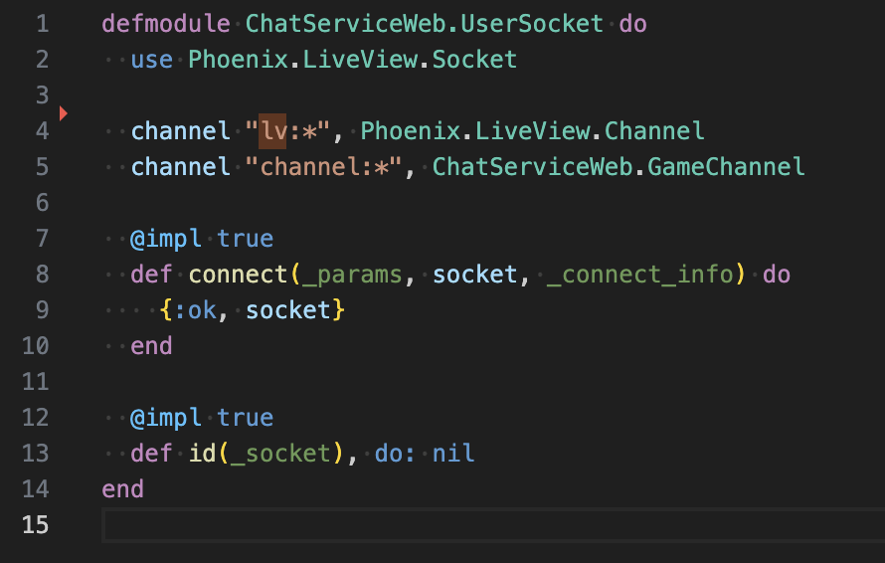
Channels
Socket channel user_socket.ex

Slide 13
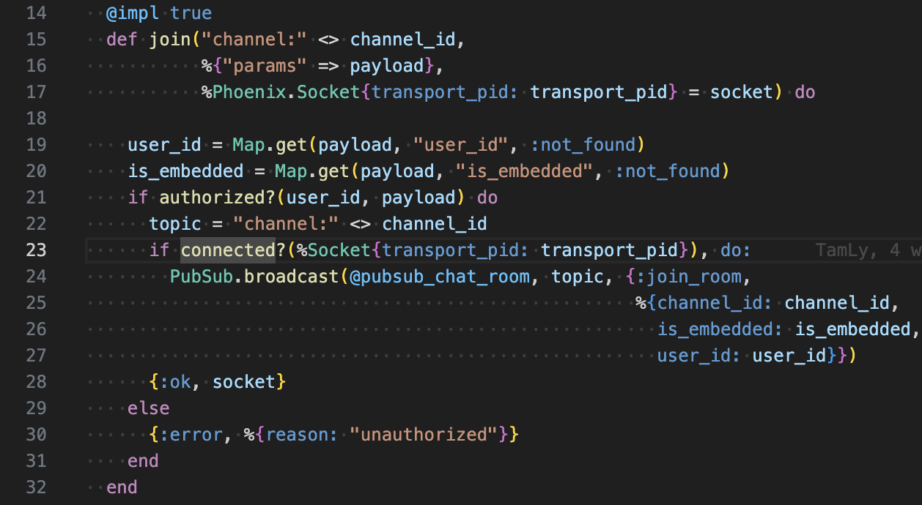
Channels
Server side: game_channel.ex, join/3 callback

Slide 14
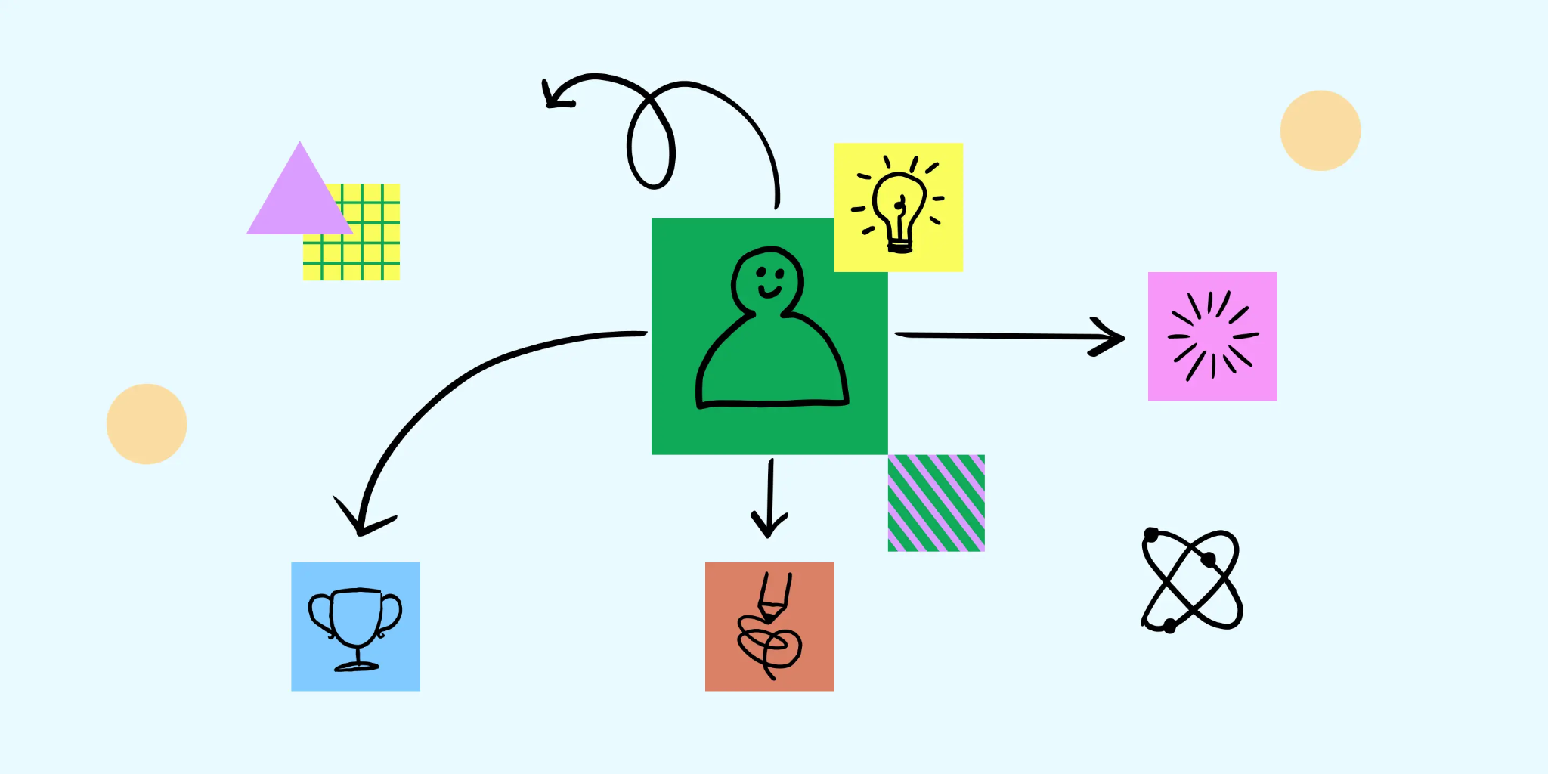
Use Cases

Slide 15
Use cases
User joins room.
User sends message.
Add user to room.
User leaves room.

Slide 16
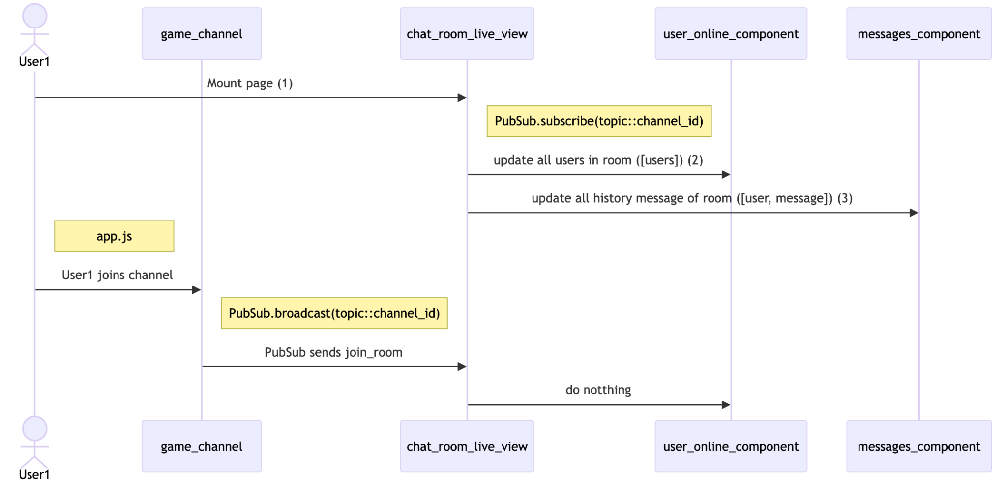
First user joins room

Slide 17
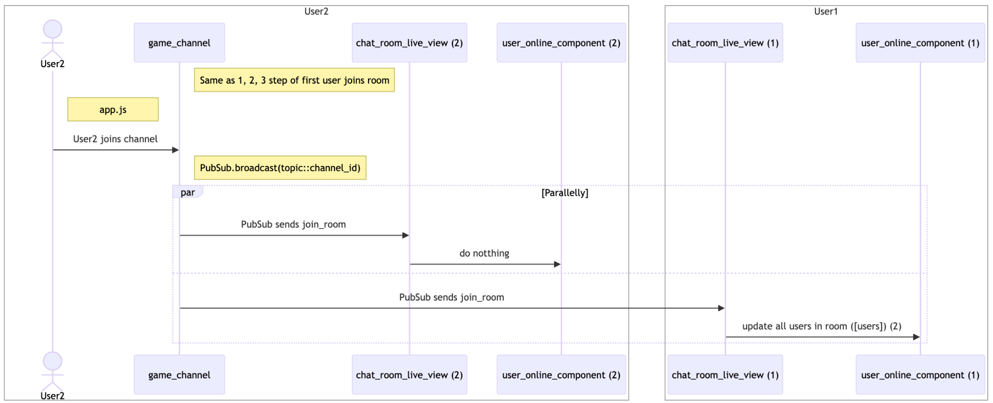
Second user joins room

Slide 18
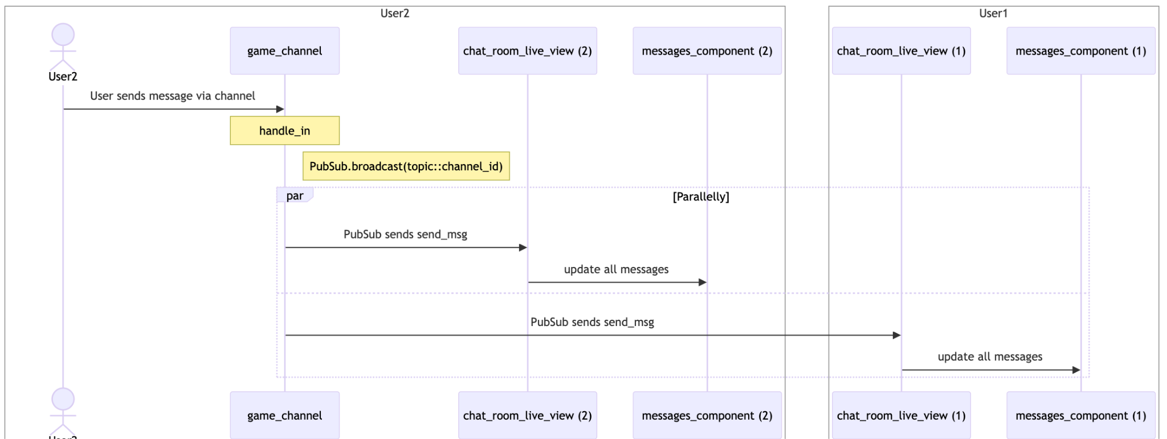
Users sends message

Slide 19
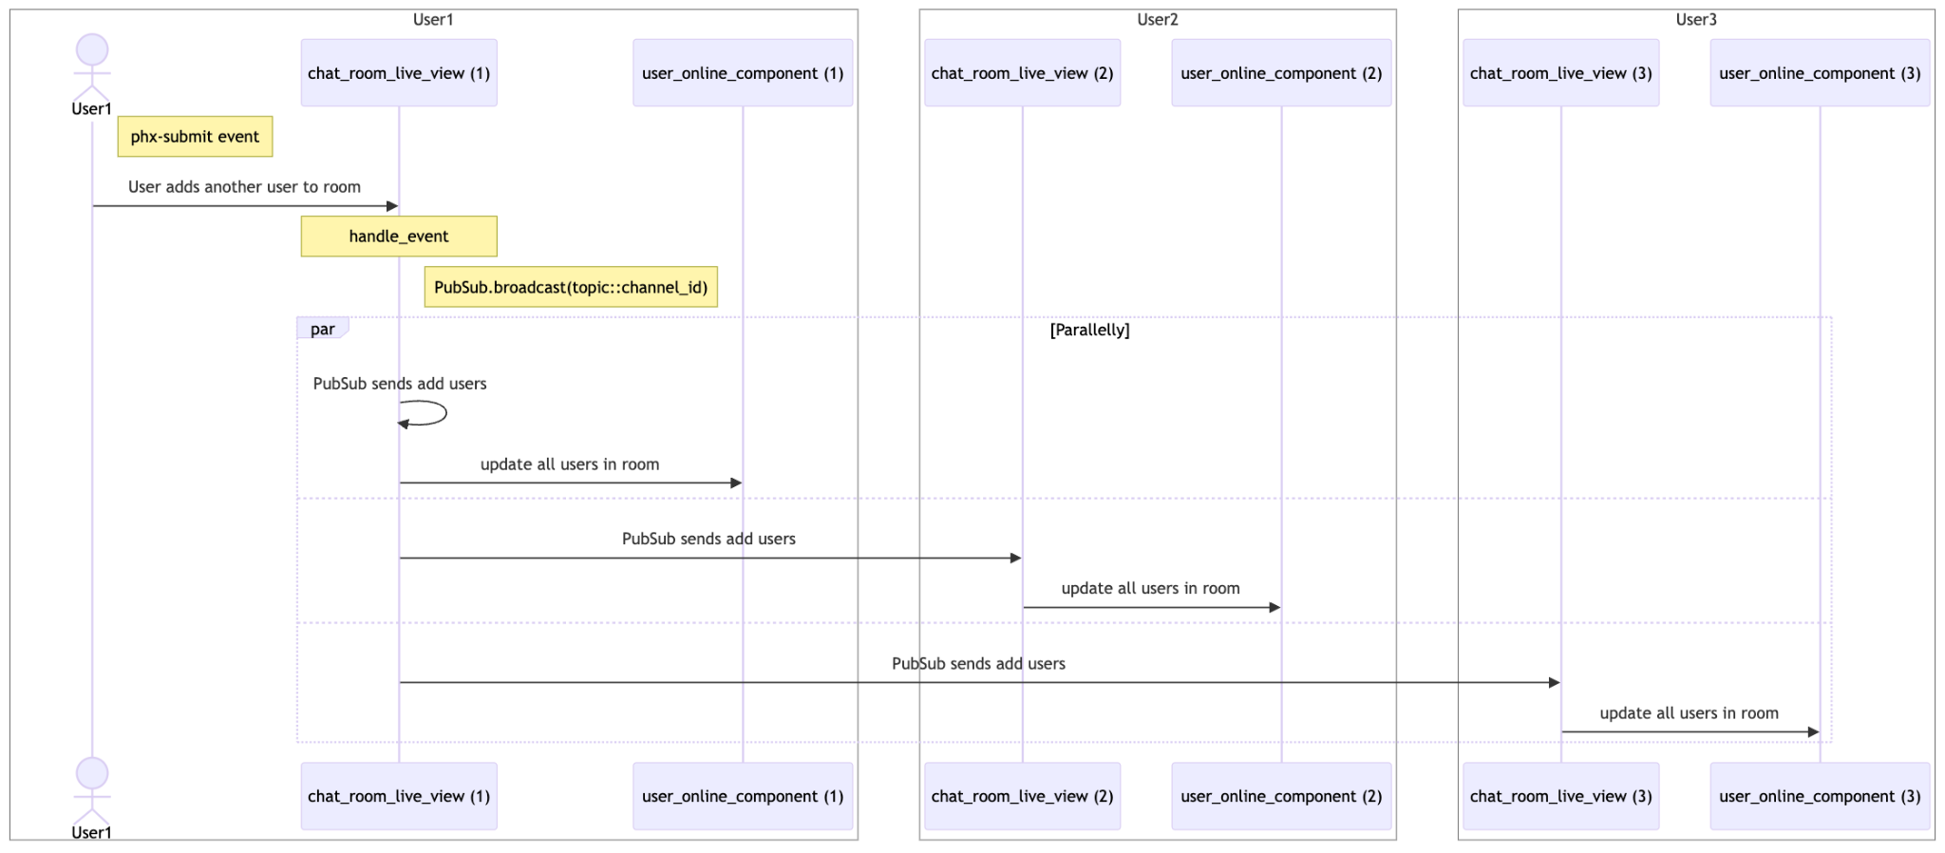
Add user to room

Slide 20
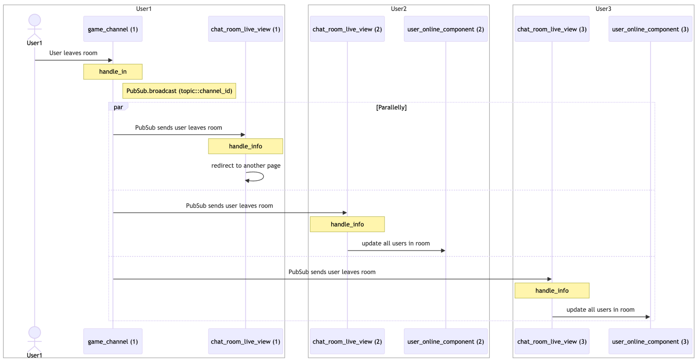
User leaves room

Slide 21
Demo (Locally)

Slide 22
ec2 Amazon AWS

Slide 23
ec2 Amazon AWS?
Amazon Elastic Compute Cloud (Amazon EC2) is a web service from Amazon Web Services (AWS) that allows users to create and run virtual machines (instances) in the cloud.
EC2 provides secure, resizable computing capacity, or servers, in Amazon's data centers that can be used to build and host software systems.

Slide 24
How to run app in ec2 instance
Creating an Amazon EC2 instance.
Installing Docker on Amazon EC2.
Building a Docker Image to tar file and copy to EC2 intances.
Configure public IPv4 address of your EC2 instance to access web app in docker container.
Using Docker compose to start containers based on image.

Slide 25
Demo (ec2 instances)

Slide 26
References
https://medium.com/@pawel_dawczak/distributed-elixir-app-in-aws-pt2-5bd29aea922a
https://medium.com/@vishwasacharya/mastering-docker-container-deployment-on-aws-expert-tips-tricks-5b73b36296aa
https://aws.amazon.com/cli/
https://docs.aws.amazon.com/cli/latest/reference/ec2/
https://docs.aws.amazon.com/ec2/
https://hexdocs.pm/phoenix/channels.html
https://hexdocs.pm/phoenix_pubsub/Phoenix.PubSub.html

Slide 27
Repo
https://github.com/ohhi-vn/embedded_chat

Slide 28


Slide 29


